Slide 1

Introducing

Slide 2

Good Morning, everyone.
Before we dive deeper into today’s orientation, I want to
introduce you to the organization powering this journey,
the institution behind the growth of thousands of
professionals in Nigeria and beyond.
Ladies and gentlemen, welcome to

Slide 3
Who We Are
A.J. Silicon is a professional, technology-driven training and
consulting firm.
We stand at the intersection of Accounting, Technology, Digital Skills, and Global Career Advancement.
We exist to equip professionals (accountants, auditors, bankers,
IT practitioners, and students) with the skills needed to thrive
in a rapidly changing world.

Slide 4
Our mission is simple:
To transform careers through practical, global-standard digital skills and certifications.

Slide 5
Our Legacy of Excellence
Over the years, A.J. Silicon has built a reputation of credibility, consistency, and impact. Our CISA training has been our flagship for decades.
We have also delivered ACCA Data Analytics Training
We are recognized nationwide as industry builders.
Many of the leading IT Auditors, Cybersecurity Analysts, and Technology Risk Experts in this country started their journey with us.
We have successfully delivered IFRS and IPSAS courses across organisations with outstanding quality.

Slide 6
Consulting & Global Projects
Directed World Bank–funded computerized financial consulting for Ogun & Niger States Water Agencies.
Designed financial systems for Nigerian Community Development & Universal Basic Education projects.
Computerization of WAEC’s accounting, HR, and audit.
Supported PAOs on digital transformation and assessment tools.
Trained Lagos State Auditor General’s Office in Information System Audit.

Slide 7
We don’t just teach.
We produce industry leaders.

Slide 8
What Makes Us Different
We fearlessly dive into new and emerging areas long before others join the space.
Why? Because A.J. Silicon is powered by professionals who are both Chartered Accountants and Technology Gurus!
This unique blend gives us mastery over finance, analytics, auditing, cybersecurity, and digital transformation.

Slide 9
We understand the
global workplace and prepare
you for it.

Slide 10
Our Expert Facilitators
Our facilitators are not ordinary instructors.
They are seasoned practitioners holding globally recognized certifications, such as: CISA, ACCA Data Analytics, CDPSE, Data Analytics Certifications, Cybersecurity Credentials, Cloud Certifications, Python and SQL Competencies and Power BI & Excel Expert Certifications.
These are professionals working in Big 4 firms, banks, fintech, telecoms, oil and gas, and international organisations.

Slide 11
You learn from those
who practice what they teach.

Slide 12
Expanding into New Technologies
We have embraced emerging technologies boldly and confidently.
Our Artificial Intelligence for Finance and Professionals Program is designed to redefine the future of accounting, auditing, finance, tax, risk management, and business decision-making. We are combining AI with Data Analytics, Audit Procedures, Compliance, Fraud Detection, Management Reporting, Business Forecasting and Strategic Advisory.
A.J. Silicon is forward-looking.

Slide 13
This is not just training.
This is career transformation.

Slide 14
Our Program Suite
We offer a comprehensive suite of professional and technical programs, including:
ACCA Data Analytics Certification
CISA Certification Training
AI for Professionals & Executives
Excel Foundation & Premium Practical Training
Power BI for Accountants & Business Leaders
Python, SQL, and Data Science Essentials
Audit Analytics & Technology Risk Programs
Consulting & Advisory Skills for Accountants

Slide 15
Everything you
need to compete globally
is available under one roof.

Slide 16
Our Track Record of Impact
We have trained professionals across Nigeria, Ghana, Cameroon, Côte d'Ivoire, Kenya, UAE, UK, US, and more.
Our alumni now work in Big 4 firms, Banks & Insurance, Fintech, Oil & Gas, Manufacturing, Government & Regulators and Global remote companies.
For many of them, A.J. Silicon was the turning point - the bridge between where they were and where they needed to be.

Slide 17
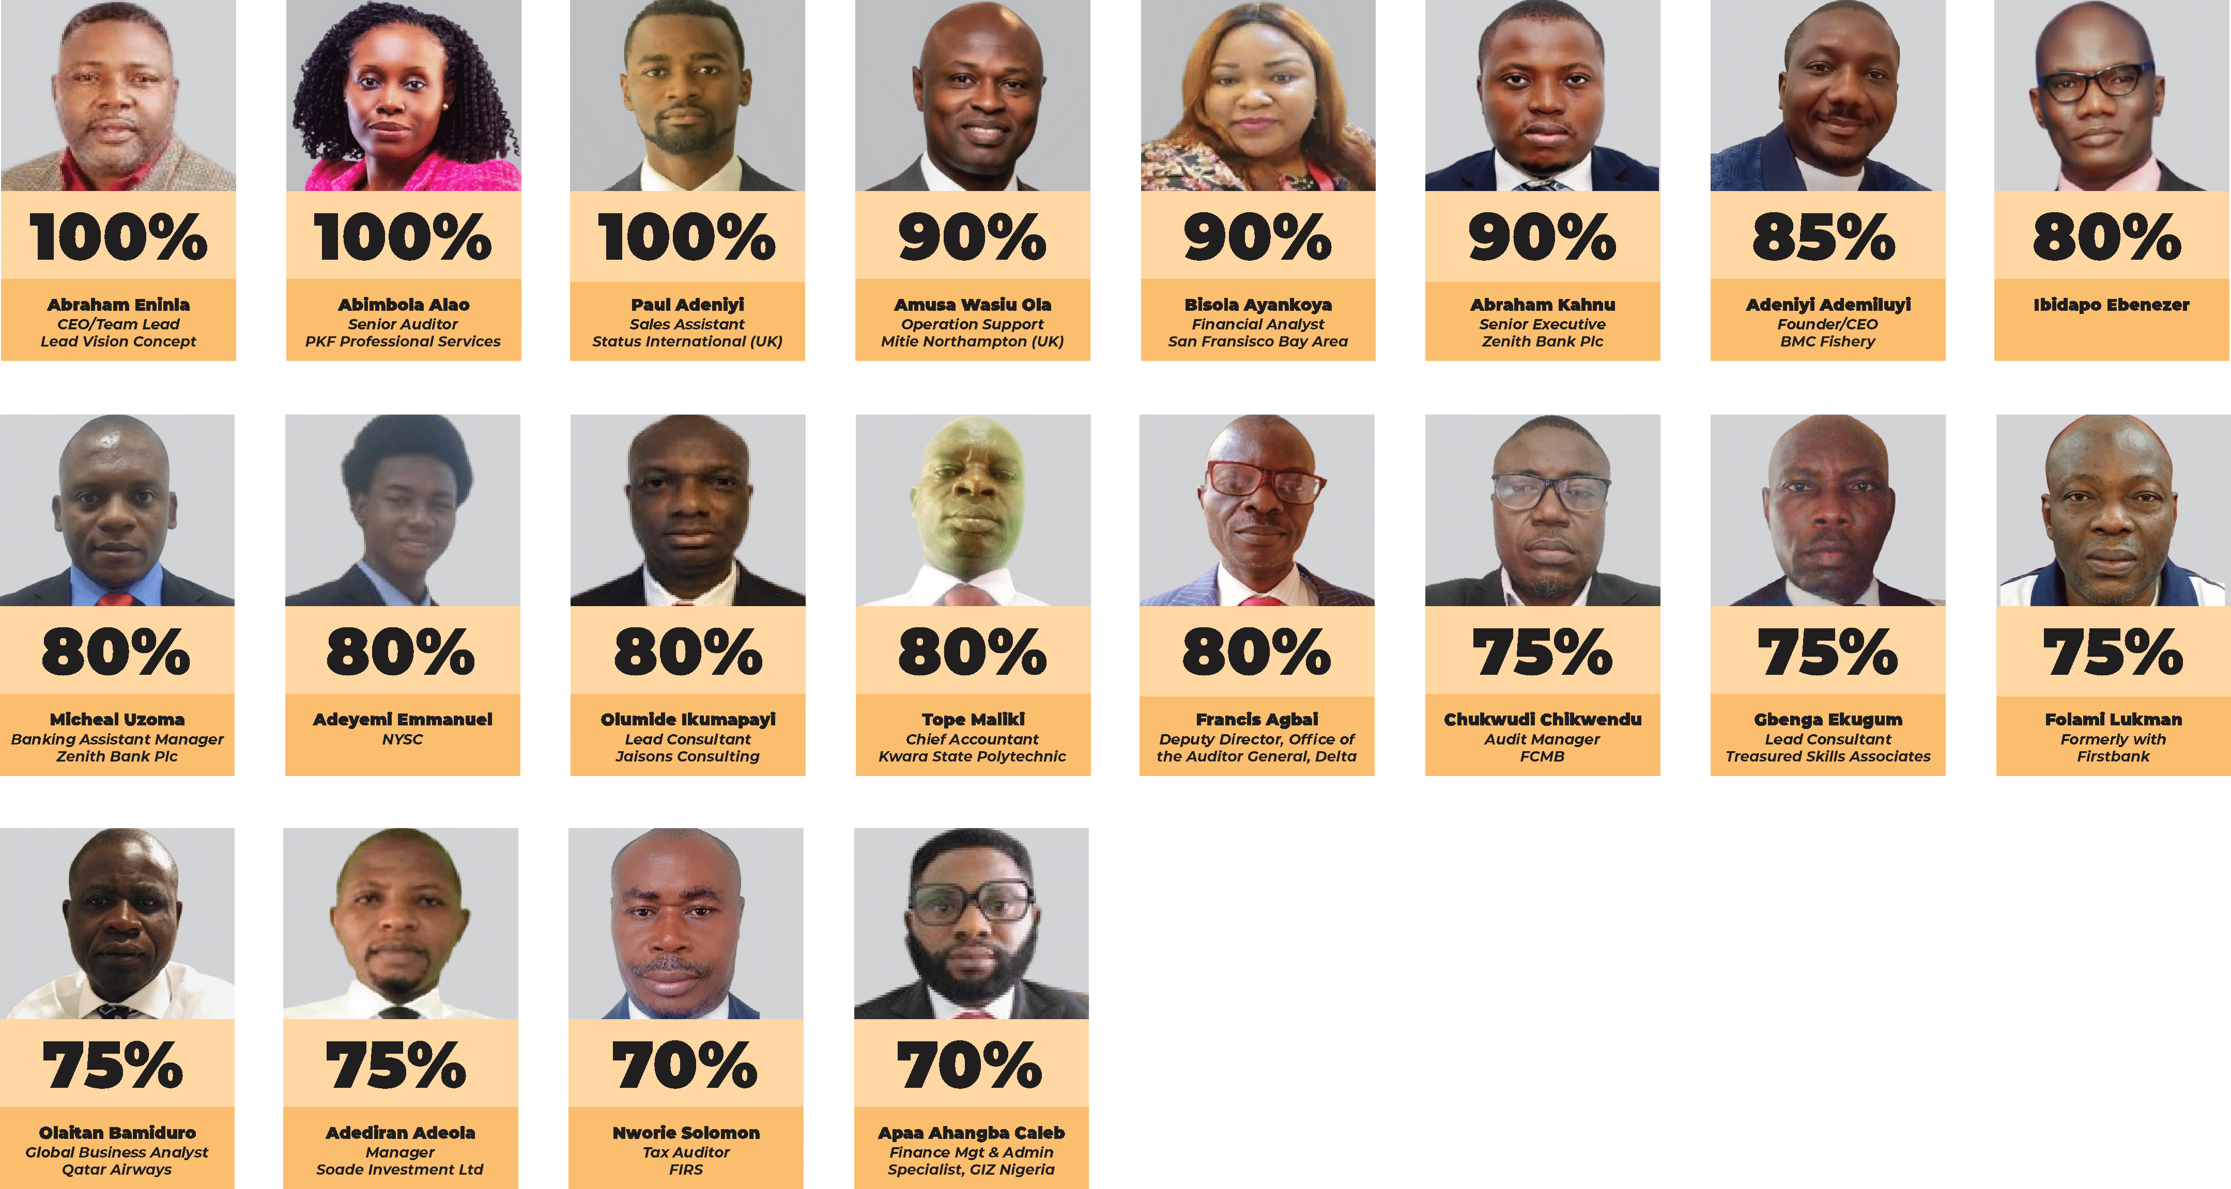
Our High Flyers
Your own journey
begins today.

Slide 18
The Future with A. J. Silicon
As the world moves toward automation, data-driven decisions, and AI-powered processes, the professionals who will rise are those with digital confidence and technical competence.
That is what A. J. Silicon stands for!
Relevance. Opportunity. Global competitiveness.

Slide 19
Join us and you will not
just survive, you will lead.

Slide 20
The Promise of A. J. Silicon
Ladies and gentlemen, when you join A.J. Silicon, you are not attending a course. You are joining a movement. You are stepping into a future where:
Your skills attract global opportunities
You qualify for foreign currency earning roles
You can work remotely or physically with global organisations
You become part of a community that grows together
When we say “join us on the cruise,” we mean exactly that.
A cruise to success, growth, and financial transformation.

Slide 21
And yes, you will land safely,
you will land in grand style, and
you will land with foreign currency
following you to the bank.

Slide 22
Welcome to Your Future
Thank you for listening.
A. J. Silicon is honored to be part of your journey.
As you begin this ACCA Data Analytics Certification orientation today, know that you are in the right place, at the right time, with the right institution.
Welcome to A.J. Silicon - where your career takes flight.

Slide 23
Profile of the Chief Consultant
Professional Overview
Dr. Razak Jaiyeola is the Chief Consultant of A.J. Silicon and Managing Partner of Razak Jaiyeola & Co. He is a Past President of the Institute of Chartered Accountants of Nigeria (ICAN) (2018/2019) and has held council roles with IFAC, PAFA, ABWA, and APBN.
Current International Engagements
Member, Professional Accountancy Organizations
Development (PAODAG) & Advisory Group of International
Federation of Accountants (IFAC)
Member, Projects Oversight Committee of PAFA.

Slide 24
Academic & Professional Achievements
Honorary Doctorate in Information Technology, British American University, Florida, USA.
Background in Chemistry; ICAN prize winner in Auditing and First Merit at Professional Final Stage.
Trained with Coopers & Lybrand.
Affiliations
Information Systems Audit and Control Association (ISACA).
Institute of Software Practitioners of Nigeria (ISPON).
Association of Certified Fraud Examiners (ACFE).
Certified in Risk and Information System Control (CRISC).
Chairman, ISPON Charter Realization Committee.

Slide 25
Career Journey
Public Service: Food and Drugs Admin (now NAFDAC).
Audit & Industry: Coopers & Lybrand, A.C. Christlieb (Trebor, Danafco), Ayor Ltd.
Professional Practice:
A.J. Silicon (IT Consulting & Training)
Razak Jaiyeola & Co. (Audit, Tax, Insolvency)
Sapphire Finance Ltd,
Neat Cars Ltd.
Tax Consulting: Messer Olusola Adekanola & Co., Consolidated Management Consultants.

Slide 26
Leadership & Boards
Former member, Local Content Consultative Committee, NERC.
Board roles: NEPAD Business Group Nigeria, One Innovation Hub Offa, MKO Abiola Gardens Residents Association.
Member, Offa Economic Development Committee.
Areas of Expertise
IT Consulting, Training, and Financial Systems Design.
Audit, Tax, Insolvency, and Secretarial Practice.
Family
Dr. Jaiyeola is married and blessed with successful children, including 4 Accountants and 4 CISAs.

Slide 27
Contact Us
WhatsApp: 09034032695, 08182955332
Email: info@ajsilicon.com
Follow Us
Facebook: facebook.com/ajsilicon
LinkedIn: https://lnkd.in/ggzAp4i5
YouTube: ajsilicon
X (Twitter): ajsilicon
Instagram: ajsilicon
Visit Us:
Address: 14B, Amara Olu Street,
Off Zenith Bank Branch, Lateef Jakande Road,
Agidingbi-Ikeja, Ikeja, Lagos.
Website: www.ajsilicon.com

