Slide 1

Understanding Data Analytics for Professionals
Presented by
Dr. Abraham Eninla (ACCA-DA, MCP, MCSE,GDAC, FMVA)

Slide 2
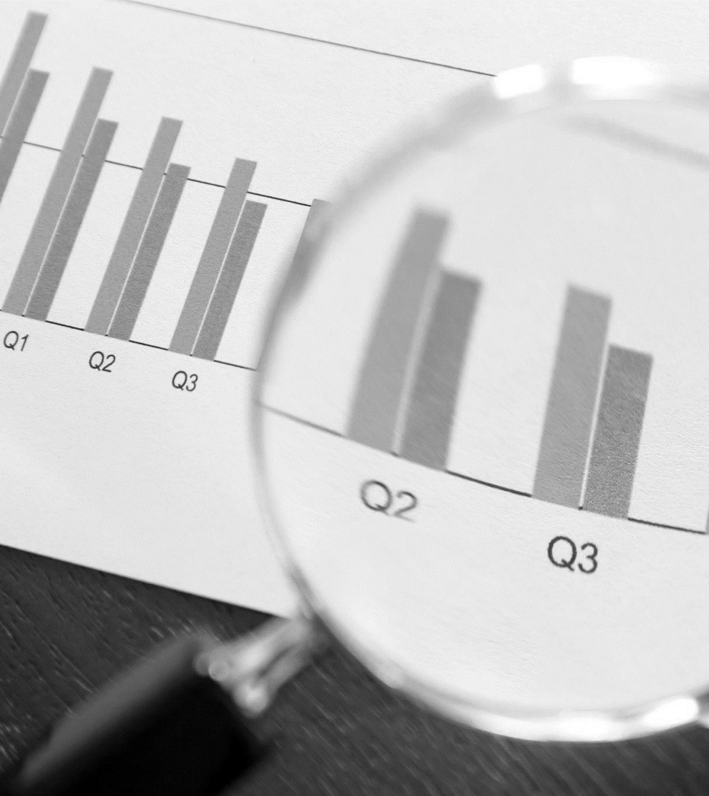
Understanding Data Analytics for Professionals
Introduction
The world is now defined by data, technology, and intelligent decision-making.
For Chartered Accountants, External and Internal Auditors, IT Auditors, Bankers, FinTech Professionals, and Tax Practitioners, understanding data analytics is not just an added skill—it is a professional imperative.
It enables better decisions, insight discovery, and leadership in a data-driven economy.

Slide 3
Understanding Data Analytics for Professionals
Systematic examination of raw data to extract insights.
Four Types:
• Descriptive – What happened?
• Diagnostic – Why did it happen?
• Predictive – What could happen?
• Prescriptive – What should be done?
What is Data Analytics?

Slide 4




Understanding Data Analytics for Professionals
Enhances decision-making and operational efficiency
Why Data Analytics Matters for Professionals?
Detects fraud and manages risk
Enables strategic planning
Promotes transparency and accountability

Slide 5
Understanding Data Analytics for Professionals
Chartered Accountants, Other Professionals and the Analytics Advantage

Slide 6




Understanding Data Analytics for Professionals
For Chartered Accountants
Performance Measurement
through KPIs
Budgeting and Forecasting
Strategic Advisory and Decision Support
Financial Integrity Monitoring

Slide 7



Understanding Data Analytics for Professionals
For Internal Auditors and Continuous Assurance
Enables Continuous Auditing and Real-Time Monitoring
Detects Control Gaps and Anomalies
Improves Compliance and Risk Management

Slide 8

Understanding Data Analytics for Professionals
For External Auditors and Audit Transformation
Analyzes full datasets (not samples)
Automates testing and fraud detection
Strengthens audit evidence with data visualization

Slide 9



Understanding Data Analytics for Professionals
Assess IT system reliability, data integrity and cybersecurity
For IT Auditors and Technology Assurance
Evaluate automated controls and ERP systems
Use tools like ACL, IDEA, Python for anomaly detection

Slide 10




Understanding Data Analytics for Professionals
For Bankers and Data-Driven Financial Services
Credit Risk
Modeling
Customer Analytics and Personalization
Fraud Detection and AML Monitoring
Regulatory Reporting Automation

Slide 11


Understanding Data Analytics for Professionals
For Fintech Professionals and Digital Disruption
AI-driven Credit Scoring and Fraud Detection
Personalized Financial Solutions
RegTech and Open Banking Innovation

Slide 12



Understanding Data Analytics for Professionals
For Tax Practitioners and Intelligent Compliance
Data Mining and Risk-Based Audits
E-Invoicing and Digital Taxation
Forecasting Revenue using Analytics

Slide 13


Understanding Data Analytics for Professionals
Manage Databases, Cloud and Automation
For IT Professionals and Data Infrastructure
Build AI Models
Ensure Data Governance and Security

Slide 14
Understanding Data Analytics for Professionals
01
Visualization:
Power BI, Tableau, Excel
Core Skills and Tools for Professionals
02
Programming:
SQL, Python, R
03
Predictive Modeling: Regression, Clustering
04
Automation Tools: ChatGPT, Azure AI
05
Data Governance and Ethics

Slide 15
Understanding Data Analytics for Professionals
Learning Pathways and Certifications
01
02
03
ACCA Certificate in Data Analytics
CISA, CISM,
CRISC
Google, IBM, Microsoft Certifications

Slide 16



Understanding Data Analytics for Professionals
Future of Work and
Data-Driven Transformation
AI, Blockchain, Big Data, Cloud Redefining Work
AI-Powered Audits, Predictive Risk Intelligence
Analytics for ESG and Sustainability Reporting

Slide 17
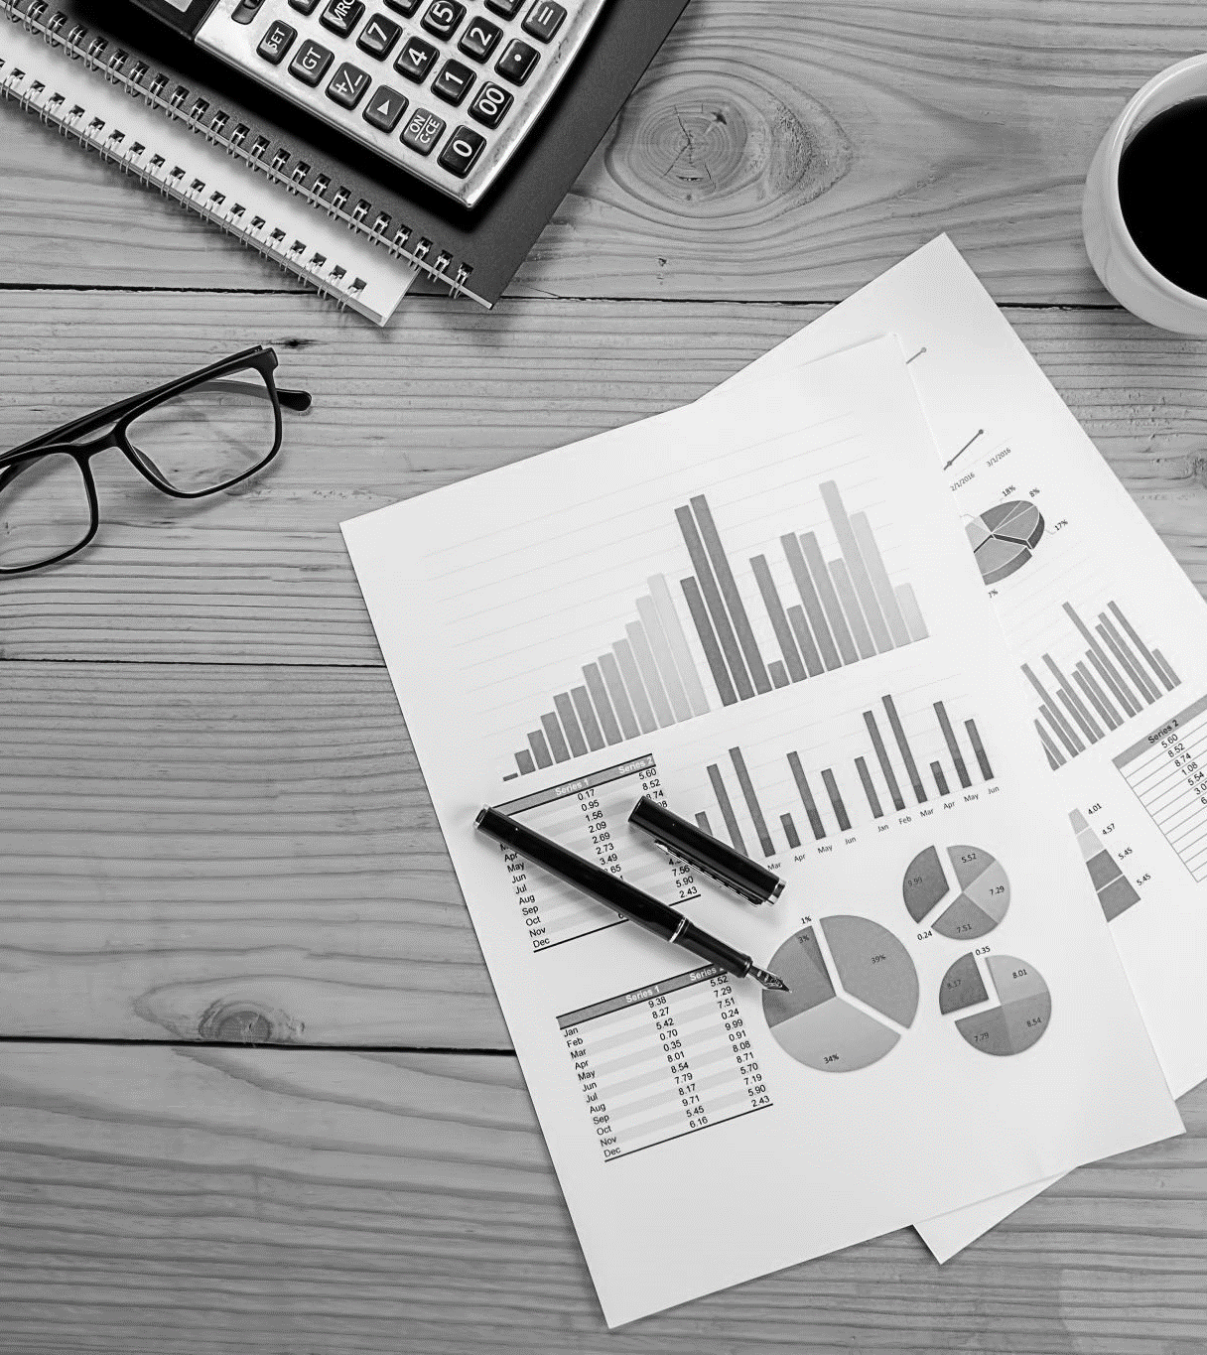
Understanding Data Analytics for Professionals
Conclusion
Data Analytics unites all professions: Accountants, Auditors, Bankers, FinTechs, and Tax Practitioners.
Those who master analytics will define the future of business and governance.

Slide 18
Visit us:
14B, Amara Olu Street, Off Zenith Bank Branch,
Lateef Jakande Road, Agidingbi-Ikeja.
Ikeja, Lagos.
Follow us:
Facebook and LinkedIn: @ajsilicon
Call us:
09071713185, 09034032695.

