Slide 1
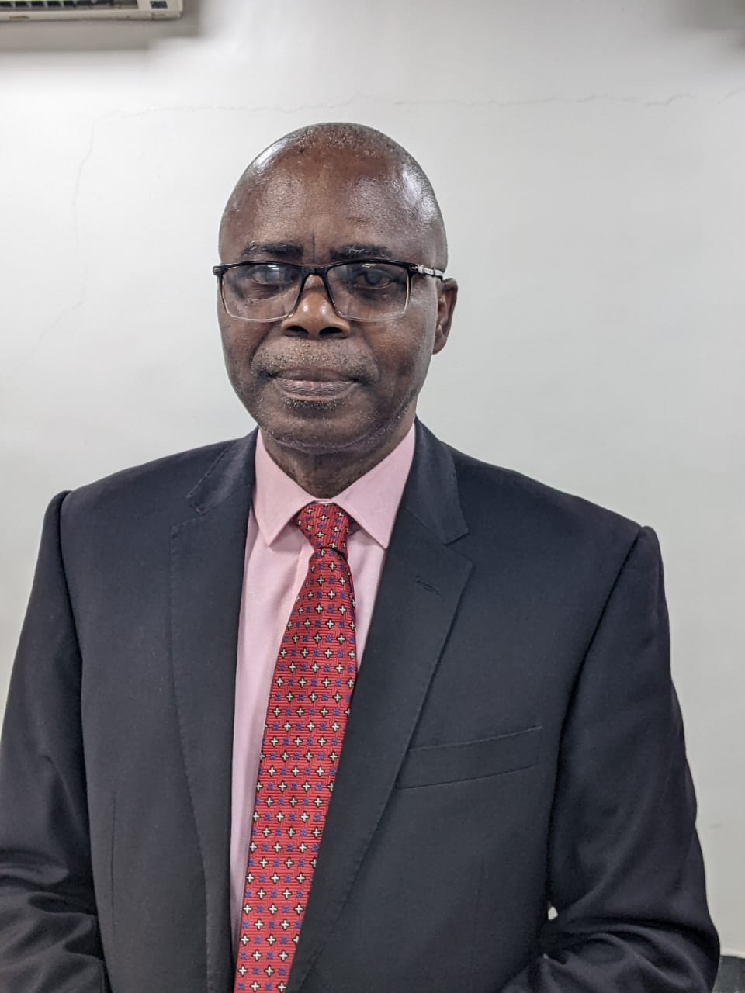
THE GLOBAL POWER OF CISA CERTIFICATION
PhD, MSc., MBA, CISA, CDPSE, PMP, FIIM, FITD, FNCS
Principal Consultant, Data Pulse Nigeria Limited

Slide 2
Introduction:
The Digital Crucible-The Stakes Are High
The world runs on interconnected Information Systems
Every connection is a potential vulnerability (increasing hacking, data breaches/system failures).
The Demand: Not just coders, but Assurance Professionals who guarantee
Confidentiality, Integrity and Availability (C-I-A Triad)
We are the Guardians of the Digital Economy

Slide 3
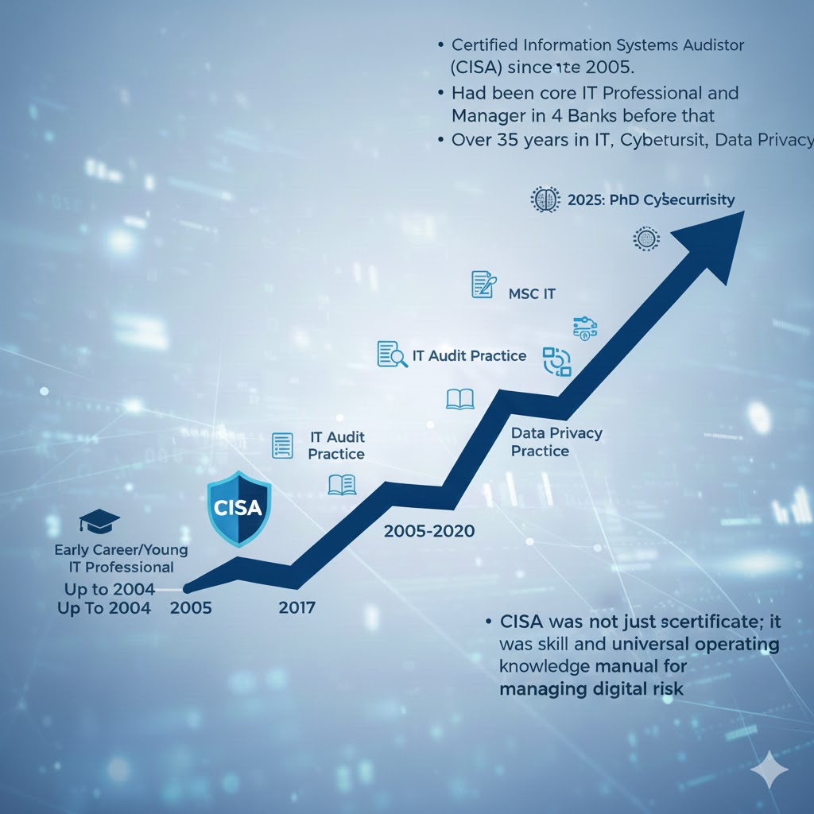
MY CISA JOURNEY
CISA was the single most powerful launchpad for my consulting career

Slide 4
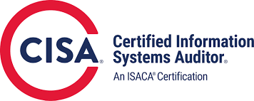
CISA: The Gold Standard for Digital Assurance
🛡️ The Five Domains: Your CISA Superpowers
1. The IS Auditing Process
  Focus: Discipline, ethics, and due diligence.
  Impact: Ensures you speak with objectivity and professional rigor.
2. Governance and Management of IT
  Focus: Aligning IT strategy with business goals.
  Impact: You learn to speak the language of the Boardroom and become a strategic advisor, not just a technician.
3. Information Systems Acquisition, Development, and Implementation
  Focus: Ensuring systems are built Secure by Design (SDLC, Project Management).
  Impact: You prevent costly fixes by securing systems from the ground up.
4. Information Systems Operations and Business Resilience
  Focus: Business Continuity Planning (BCP) and Disaster Recovery (DRP).
  Impact: Ensures the business can survive any crisis and maintain operations.
5. Protection of Information Assets
  Focus: Cybersecurity & Data Privacy control framework.
  Impact: You safeguard data—the ultimate organizational asset—by applying necessary controls.
  My CISA foundation perfectly complements my work in Data Privacy (CDPSE), providing the assurance framework needed for effective governance

Slide 5
The Power Unlocked: Career Transformation
Since earning my CISA Certification in 2005, it has been my Professional Passport
First, it brings Global Currency and Recognition
Second, it guarantees Competitive Edge and Salary Potential
Third, it grants unmatched Versatility.
I started as an IT Auditor. Today, my CISA foundation allows me to serve as a Principal Consultant, advising on Data Privacy regulations, leading Cybersecurity governance, and managing complex IT projects. CISA is the master key that unlocks roles such as:
Core Role: Senior IT Auditor
Security: Information Security Analyst
Compliance: Risk and Compliance Manager
Data Privacy: Data Privacy Officer (DPO)
Leadership: Chief Information Officer (CIO)
CISA is a master key to diverse, high-value roles

Slide 6
Why IT Audit Skills Are Now Mandatory
70–90 percent of business processes now run on IT systems
Without IT audit skills, auditors cannot properly evaluate:
  Access controls
  Cybersecurity
  ERP systems
  Data integrity
  System changes & configurations
Regulators (CBN, SEC, NDIC, EFCC) now expect IT Audit competencies
Big 4 audit firms and top firms recruit more IT auditors than traditional auditors
If you want to remain relevant in auditing, finance, risk, or compliance, you must understand IT.

Slide 7
Why CISA Is No Longer Optional for Audit Professionals
Traditional audit roles are disappearing
AI and automation now handle routine accounting and simple assurance tasks
Only skills in systems, controls, cybersecurity, and risk will survive
Organisations now prefer auditors who can:
  Test IT controls
  Review cyber posture
  Analyse digital risks
  Audit ERP, cloud, and data systems
CISA is the certification that future-proofs your career against automation and AI.

Slide 8
The Global Power of CISA
CISA is the world’s No. 1 certification for IT Audit and Cybersecurity Assurance.
Recognized across:
Banks
Oil & Gas
Telecoms
Big 4 Audit Firms
FinTechs
Government agencies
Global institutions (US, UK, Canada, Middle East, Europe)
It is the fastest route for accountants and auditors to transition into high-demand IT roles. CISA-certified professionals earn far higher salaries than traditional auditors
Many CISA holders now secure remote foreign-currency jobs without relocating
CISA dramatically increases your earning power and opens global doors.

Slide 9
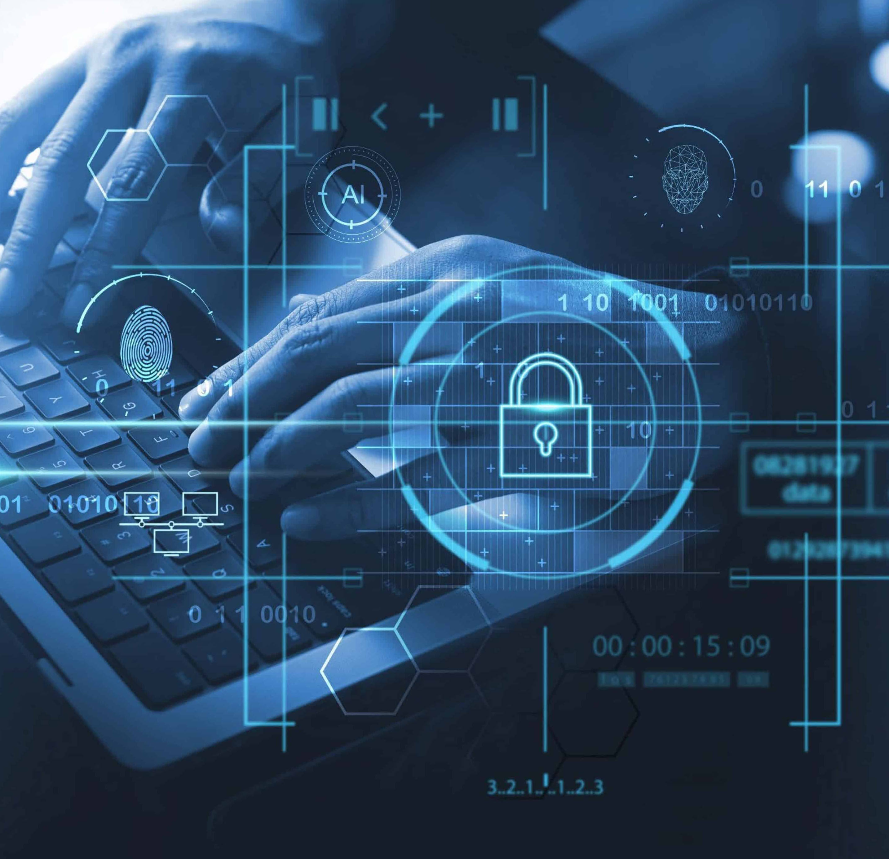

CISA gives access to:
Dollar-paying remote jobs
Premium audit and risk roles
High-value consulting engagements
Cross-border project opportunities
Real Earnings Motivation
Your income can grow
significantly with one certification
The Certification That Transforms Accountants Into Global IT Audit Professionals
Global Power of CISA

Slide 10
The CISA Mindset: Integrity and Action
The true power of CISA is not just the knowledge; it is the mindset it creates. It instills a sense of ethical responsibility and due diligence.
As a CISA professional, you are the one trusted to tell the unvarnished truth to management and the Board. Your credibility is your most important asset.
As the saying goes, "Your integrity is worth more than your career." CISA grounds you in that ethical foundation.

Slide 11
Call to Action
Study and Pass the Exam Immediately: The knowledge itself is invaluable. Pass the CISA exam now, while your academic knowledge is fresh. Your exam results remain valid for a period (currently five years) while you accrue the work experience.
Seek Relevant Roles: Actively pursue entry-level roles in IT support, information security, compliance, or quality assurance. Even a technical role becomes relevant experience when you apply the CISA assurance mindset—documenting controls, identifying weaknesses, and improving processes. Every job can be aligned as a CISA job if you look at it through the lens of risk and controls.
Leverage the Community: Join your local ISACA chapter. Network with professionals like myself. We are here to mentor you, help you connect your studies to real-world scenarios, and validate your experience when the time comes

Slide 12
Points to Ponder About
We live in the age of risk. Your generation has the technical skill
The CISA framework provides the necessary governance and assurance
Use the CISA mindset to build the Digital Trust the world desperately needs
"The best way to predict the future is to create it." — Peter Drucker. Start creating your CISA future today.
I joined ISACA and chose CISA more than 20 years ago, and it has provided a tremendous return on investment, not just financially, but in terms of professional recognition, global mobility, confidence and competence and the satisfaction of ensuring digital trust.
My challenge to you is to stop viewing CISA as just another certificate. View it as your passport to the Digital Assurance Frontier. Start creating your future today by embracing this journey. The digital world is waiting for your leadership.

Slide 13
Highly experienced facilitators
Led by a Past President of ICAN
20+ years experience in IT audit & governance
Practical teaching with real case studies
Mentoring until exam success
Strong professional community
The A.J. Silicon Advantage
The Certification That Transforms Accountants Into Global IT Audit Professionals
Global Power of CISA

Slide 14
Examples of real transformation:
Participants now working in banks and Fintechs
Accountants earning in dollars through remote roles
Professionals entering Big 4 IT audit
Consultants expanding their services using CISA
Success Stories
Your success story can be next
The Certification That Transforms Accountants Into Global IT Audit Professionals
Global Power of CISA

Slide 15
10 Weekend Sessions
Saturdays: 12pm – 5 pm
Sundays: 2 pm – 5 pm
Includes:
Deep explanation of CISA domains
Practical IT audit sessions
Exam-focused strategy
Revision and mock questions
Class Format
The Certification That Transforms Accountants Into Global IT Audit Professionals
Global Power of CISA

Slide 16

QUESTIONS AND ANSWER SESSION
For enquiries and registration:
Call 09130232184, 08182955332
info@ajsilicon.com

