Slide 1

Introduction to CISA Certification
Your Pathway to Global IT Audit Excellence
Yomi Abiona
Chief FCA, ACTI, CISA, CERT IN IFRS(ACCA)
Why the CISA certification is a powerful next step for accountants

Slide 2
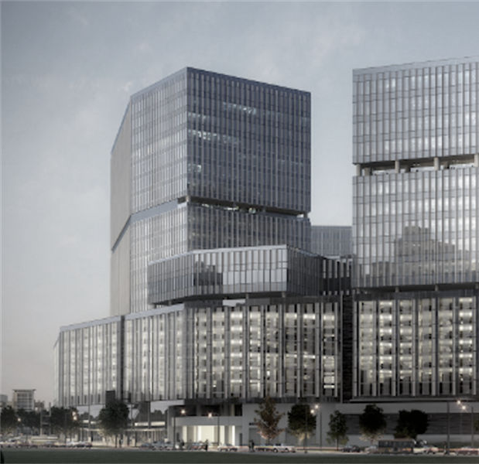

01
About ISACA
Founded in 1969, USA HQ
Global body for IT audit, governance, cybersecurity
170,000+ members worldwide
Certifications: CISA, CISM, CRISC, CGEIT, CDPSE
Presence in 180+ countries
Introduction to CISA
Your Pathway to Global IT Audit Excellence

Slide 3
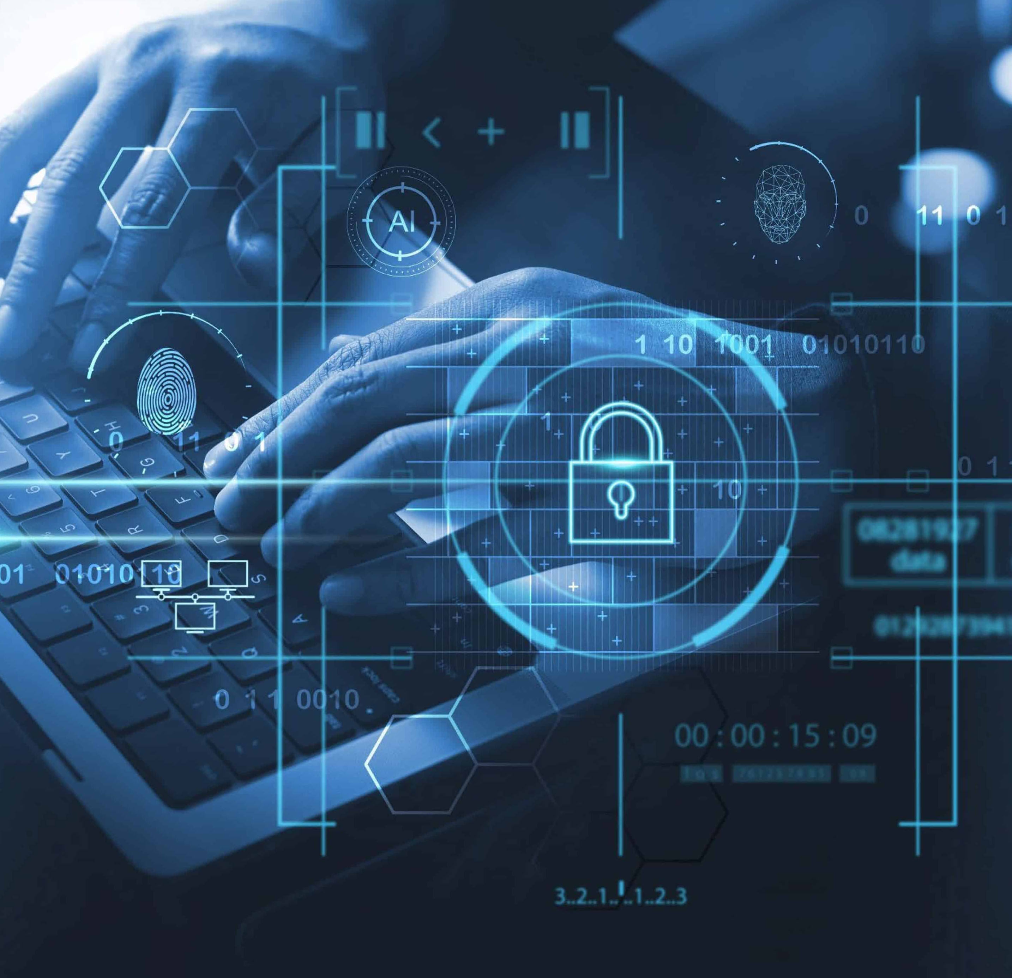
02
Leading global IT audit certification
Validates skills in assessing and assuring information systems
Required across banking, telecom, fintech, government, consulting
ONE-STAGE EXAM
Backed by ISACA’s global professional community
What is CISA?
Introduction to CISA
Your Pathway to Global IT Audit Excellence

Slide 4
03
Globally recognised in 180+ countries
High industry demand
Strong earning potential including remote global jobs
Enhances credibility and consulting capability
Ideal for auditors, accountants, and IT professionals
Why Become a CISA
Introduction to CISA
Your Pathway to Global IT Audit Excellence

Slide 5
04
Over 45 years of global relevance
Ranked among top 5 highest-paying IT certifications
Required for IT audit roles globally
Key qualification for cybersecurity and digital assurance
Increasing adoption in Africa
Current Certification Facts
Introduction to CISA
Your Pathway to Global IT Audit Excellence

Slide 6
05
Domain 1: 18%
IS Auditing Process
Domain 2: 18%
Governance and Management of IT
Domain 3: 12%
IS Acquisition, Development and Implementation
Domain 4: 26%
Operations and Business Resilience
Domain 5: 26%
Protection of Information Assets
CISA Domains & Percentages
Introduction to CISA
Your Pathway to Global IT Audit Excellence

Slide 7
06
One-stage global exam
Computer-Based Test
150 multiple-choice questions
4 hours duration
Passing score: 450/800
Can be taken at test centres OR online from home (remote proctoring)
Exam Structure
Introduction to CISA
Your Pathway to Global IT Audit Excellence

Slide 8
07
Lagos
Abuja
Port Harcourt
Exams can also be taken online from home via online remote proctored .
Test Centres in Nigeria
Introduction to CISA
Your Pathway to Global IT Audit Excellence

Slide 9
08
ISACA Membership:
$165
CISA Exam Fee (Member):
~$575
CISA Exam Fee (Non-member): ~$760
Fees subject to periodic updates
Membership & Exam Fees
Introduction to CISA
Your Pathway to Global IT Audit Excellence

Slide 10
10
Revenue Assurance Analyst
Review of System after Implementation
Review for ERP Implementation
Opportunities Abroad
Chief Information Officer
External/Internal Auditing
Internal/Financial Control
Security Consulting
Disaster Recovery Specialist
Bank Examiner/Supervision
Complement to other qualifications
Career Opportunities
Introduction to CISA
Your Pathway to Global IT Audit Excellence

Slide 11
12
Dr. Olumide Olowokure
B.Sc, FCA, CISA
Fakiyesi Ilesanmi
MBA, FCA, CISA, CISM
Joseph Akoki
FCA, MBA, CISA, Certified ISO 22301
Yomi Abiona
B.Sc, FCA, ACTI, CISA, Cert. in IFRS (ACCA)
Our
Facilitators
Introduction to CISA
Your Pathway to Global IT Audit Excellence

Slide 12
12
Tunji Adeoje
CISA, CEH, CHFI, OCP, CTT+
Abolarin Babatunde
BSc, MSc, FCCA, CISA
Seyi Ojedokun
CISA, CISM, PCIDSS ISA, ECSA, CEH
Sanni Yusuf
FCCA, ACA, CISA, B.Sc, M.Sc, ISO Lead Auditor
Hammed Kamorudeen
B.Sc, ACA, AAT, CISA, ISC2(CC)
Our
Facilitators contd.
Introduction to CISA
Your Pathway to Global IT Audit Excellence

Slide 13
13
10-week training program
Saturdays: 12 pm – 5 pm
Sundays: 2 pm – 5 pm
Includes revision, case studies, and practice questions
Weekly Weekend Lecture Periods
Introduction to CISA
Your Pathway to Global IT Audit Excellence

Slide 14
14
Training Fee: ₦175,000
Full payment required before training
Live Zoom sessions
Continuous support until exam success
Bank Details
A.J. Silicon - Zenith Bank
Account Number: 1011669864
Send proof of payment to:
09130232184 via whatsapp
Training Fee, Payment Terms & Bank Details
Introduction to CISA
Your Pathway to Global IT Audit Excellence

Slide 15
The world will reward those who evolve.
CISA is your EVOLUTION
Your moment is now. Take the step.
Introduction to CISA
Your Pathway to Global IT Audit Excellence

Slide 16
Address: 14B, Amara Olu Street, Off Zenith Bank Branch, Lateef Jakande Road, Agidingbi-Ikeja.
Ikeja, Lagos.
Website: www.ajsilicon.com
Email: info@ajsilicon.com
Follow us:
Facebook and LinkedIn: @ajsilicon
Call us:
09130232184, 08182955332

